Slide 1
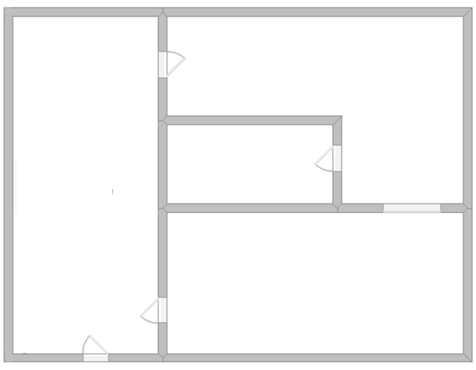
Problem solving with estimation and rounding
Task A: Problem solving with estimation
1) Here is a scaled drawing of a ground floor house. Given the dimensions, can you work out an estimate for the missing dimensions? Show your working out.
Here we have rounded each number to the nearest 5.
34.68 m²
…… m
33.62 m²
……… m²
Given the diagram is to scale, the 15 m can be approximately divided into the ratio of 1 : 2 so we have 5 m and 10 m.
32.32 m²
13.83 m
4 m
Therefore to make the 30 m²
we know this length should be approximately 3 m.
35 m²
35 m²
……. m²
3 m
The remaining length should be slightly greater than 3 because we have 35 m². A good estimate would be 4 m.
30 m²
5 m
10 m
So the missing area and the area of 35 is expected to sum to 40 m².
So the missing area is approximately 5 m².
Lots of different ways you could have worked this out.
Anything between 6m and 10 m is acceptable.
Anything between 4 m² and 8 m² is acceptable.

Slide 2
Problem solving with estimation and rounding
Task B: Problem solving with error intervals
1) A rectangle has a square removed from the centre.
Work out the error interval for the shaded area.
0.8 cm (to 1 d.p.)
Length of square : 0.75 ≤ l_{s} < 0.85
Area of square: 0.5625 ≤ a_{s} < 0.7225
1.4 cm
(to 1 d.p.)
Length of rectangle : 3.5 ≤ l_{r} < 4.5
width of rectangle : 1.35 ≤ w < 1.45
Area of rectangle:
3.5 × 1.35 ≤ a_{r} < 4.5 × 1.45
4.725 ≤ a_{r}< 6.525
4 cm (to 1 s.f.)
Area of shaded:
4.725 - 0.7225 < shaded <6.525 - 0.5625
4.0025 < shaded < 5.9625
Task C: Using Fermi estimation
1) How much rubbish in tonnes does the UK produce every year? (without a calculator)
Hint - If you don’t have data to hand, think about how much your household throws away each week.
There are lots of ways to estimate this.
The average household produces 20 kg of rubbish per week
Rounding 52 to 50, this is then 20 × 50 = 1000 kg of rubbish per year per household
There are approximately 27 million households
Rounding 27 to 30, this means 30 000 000 × 1000 = 30 000 000 000 kg
Converting to tonnes
30 000 000 000 ÷ 1000 = 30 000 000 tonnes

Slide 3
Problem solving with estimation and rounding
2) How many pennies would it take to make a stack the height of the Statue of Liberty? (without a calculator)
Hint - If you don’t know the thickness of a penny, measure one.
The thickness of a penny is 1.52 mm, so round this to 1.5 mm
The Statue of Liberty is 93 m high, so round this to 90 m
The calculation is 90 m ÷ 1.5 mm
So converting 90 m to mm we have 90 000 mm
The calculation is 90 000 mm ÷ 1.5 mm = 60 000 pennies
3) How many tennis balls can fit into your bedroom?
There are lots of different strategies to work this out and is pupil dependent.
Measuring the dimensions of the bedroom and given a tennis ball has a standard diameter of 6.85 cm, a pupil can work out an approximation of how many tennis balls are needed to fill their bedroom.
Mathematics in Education and Industry
v2.3

